Slide 1
AVINSoR
Tej Birring (gsb4@kent.ac.uk)
Dr. Peter Lee (p.lee@kent.ac.uk)
A Visually Intelligent Navigation System for application in Robots
URL: www.birring.net/tej

Slide 2
The Aim
What AVINSoR aims to achieve.

Slide 3
Aims
The Ultimate Aim
To demonstrate the ability of an embedded system to perform autonomous exploratory navigation, within a miniature ALV (Autonomous Land Vehicle).
A “training process” should define and refine the robot’s perception and behaviour via supervisory input.
Notes:
A Miniature Autonomous Land Vehicle is essentially a small vehicle or robot with 4 wheels designed to move on land only.
The rest will become clearer as we proceed.

Slide 4
Technical Aim of System (Abstract)
Digital Input
Stereo Camera
Visual Perception
(of environment and the current state)
Cognition “Connects Perception With Behaviour”
Behavioural Patterns
(of environment and the current state)
Digital
Outputs
Actuator Controllers
Generic Digital Inputs for other Sensors
(optional)
Digital Input
Supervisory ‘Training’ Commands
Notes:
Our Technical Aim is to:
Create spatial perception (of the environment around the vehicle, and of the current state of the vehicle itself) – from vision. This process relies on:
Input from a stereo camera module. 2 cameras side by side. Each individual camera allows for absolute magnitude of luminosity to be detected for Red, Green and Blue light along 2D space (i.e. X and Y axis). However, with a 3rd camera, we can generate a disparity map, which allows for a 3rd perception, of depth (Z axis).
Additional Digital Inputs for use by other sensors. Like in humans, additional sensory data would allow for more accurate perception of visual features through training. FOR EXAMPLE: If I present Vodka, to those amongst us that are not teetotallers, if your nose is blocked and you cannot smell it, and are not allowed to taste it, you would presume it’s water. Those extra senses allow for easy differentiation of the two transparent liquids which look alike.
A Supervisory ‘Training’ Command will allow for synaptic connections to be made or adjusted. This will allow for the particular input patterns (from sensory data inputs) to be categorized as a recognizable feature.
We need to create Behavioural Patterns – In other words teach the vehicle or robot how to control its ‘actuators’ – we assume this to be a function of time and sensory inputs (which means: present inputs and the sequence of previous inputs).
Again, teaching would be done through supervisory ‘training’ commands.
There needs to be a cognitive process which allows for the Visually Recognizable Features to be mapped to Behavioural Patterns.
So we are effectively creating a system which produces correct navigational outputs from sensory inputs through learning.
You may have noticed that the lines connecting “the cognitive process“ with “visual perception” and “the behaviour pattern learning” process do not have arrows. THIS IS BECAUSE THE LOGICAL MATHEMATICAL MODEL OF THE LEARNING PROCESSES HAS NOT YET BEEN CLEARLY DEFINED.

Slide 5
Background
Visual Perception? Autonomous Exploratory Navigation?
…What is this? I don’t get it.

Slide 6
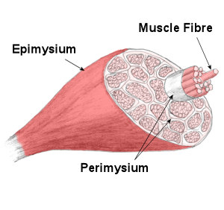
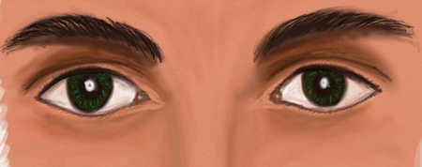
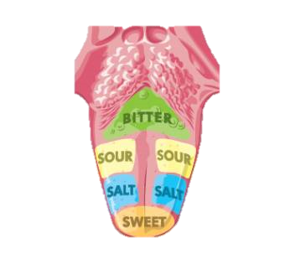
Visual Perception
Digital Input
Stereo Camera
Visual Perception
(of environment and the current state)
Cognition “Connects Perception With Behaviour”
Behavioural Patterns
(of environment and the current state)
Digital
Outputs
Actuator Controllers
Generic Digital Inputs for other Sensors
(optional)
Digital Input
Supervisory ‘Training’ Commands
Notes:
The system described earlier is a bio-inspired approach, based on research of human psychology (i.e. how the brain works) particularly with regards to perceiving our spatial environment through vision and other senses.
“Research show that in any given picture, eye-search records always show that the brain seeks what it thinks it needs - depending on what it thinks it's seeing and the current task at hand. I.e. movements when driving a car will be different when reading, etc.”
“The eye's images are almost useless until the are read in terms of properties ofobjects, and because survival depends on behavior being appropriate to the immediate future with no delay. We also know that the eye and brain takes time to respond to the present, and that present behavior in entirely dependent on our anticipation of what is likely to happen in the future, rather than immediate stimuli.
Seeing objects involves general knowledge of objects (a set of rules), derived largely from previous experience and active hands-on exploration.”
If we look back at the system. The stereo camera input can be considered the computer equivalent of our stereoscopic eyes.
The Generic Digital Inputs can be considered the equivalent of touch, taste, smell, and our ability to hear - if they where treated as auxiliary (extras).
The Digital Outputs can be considered the equivalent of our skeletal muscles – which we can consciously or sub-consciously control to create movement.
The large chunk in the middle can be considered our brain (which includes our memory) – long term memory is particularly important in humans to remember sensory perceptions and behavioural patterns.

Slide 7
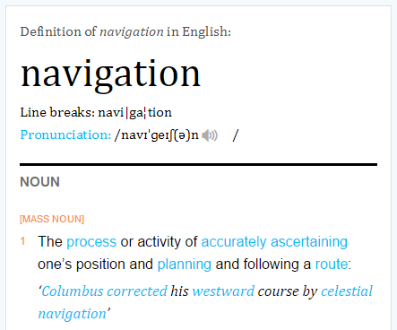
What is Navigation?
Navigation is to know ones position in the current moment.
Navigation is to have an accurate idea of the destination.
Navigation is to plot a route from current location to destination.
Navigation is to follow that route.
Navigation is all of the above.
This is what the Oxford Dictionary says.
Courtesy: OxfordDictionaries.com,
© 2014 Oxford University Press
Notes:
(1) CURRENT POSITION: Eliot Becket Court seminar room 17
(2) DESTINATION: Essentials

Slide 8
What is Autonomous Navigation?
A vehicles ability to navigate without any external input (apart from, perhaps, desired destination, OR in exploratory systems, features of interest).
Notes:
Features of Interest – patterns of signals which may be sensed from the environment.

Slide 9
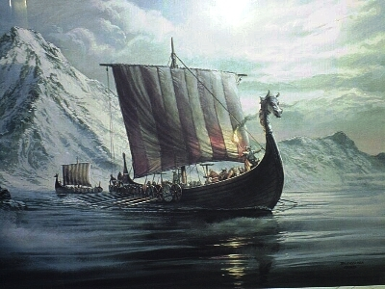
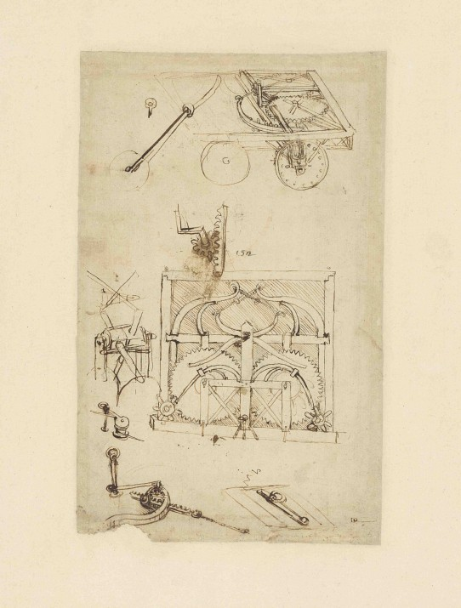
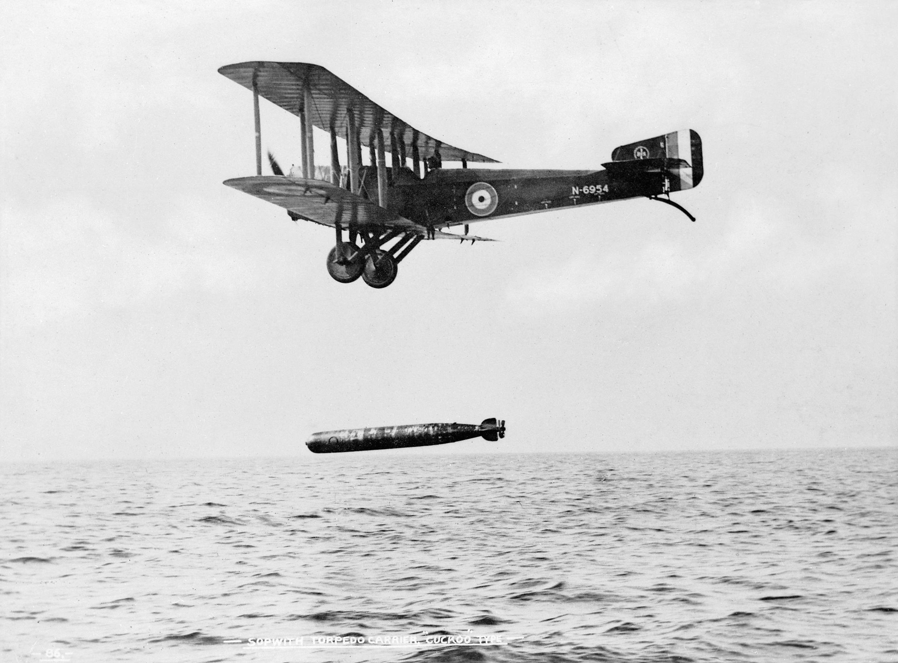
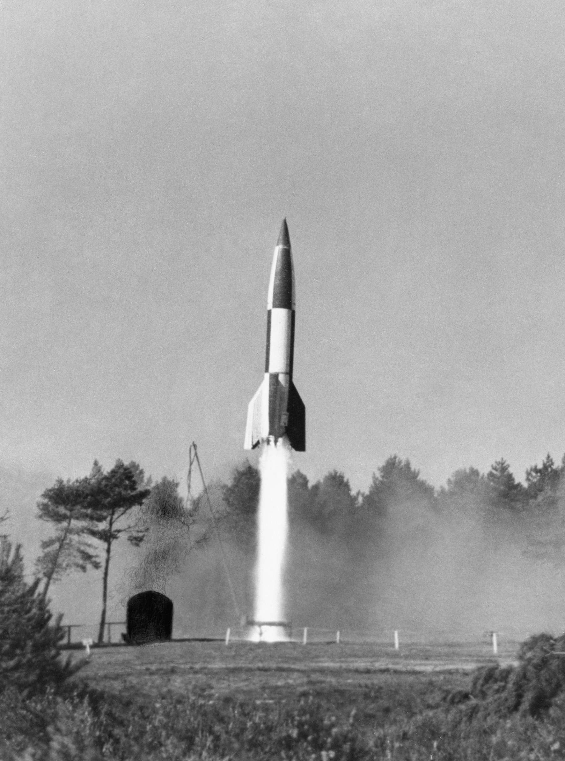
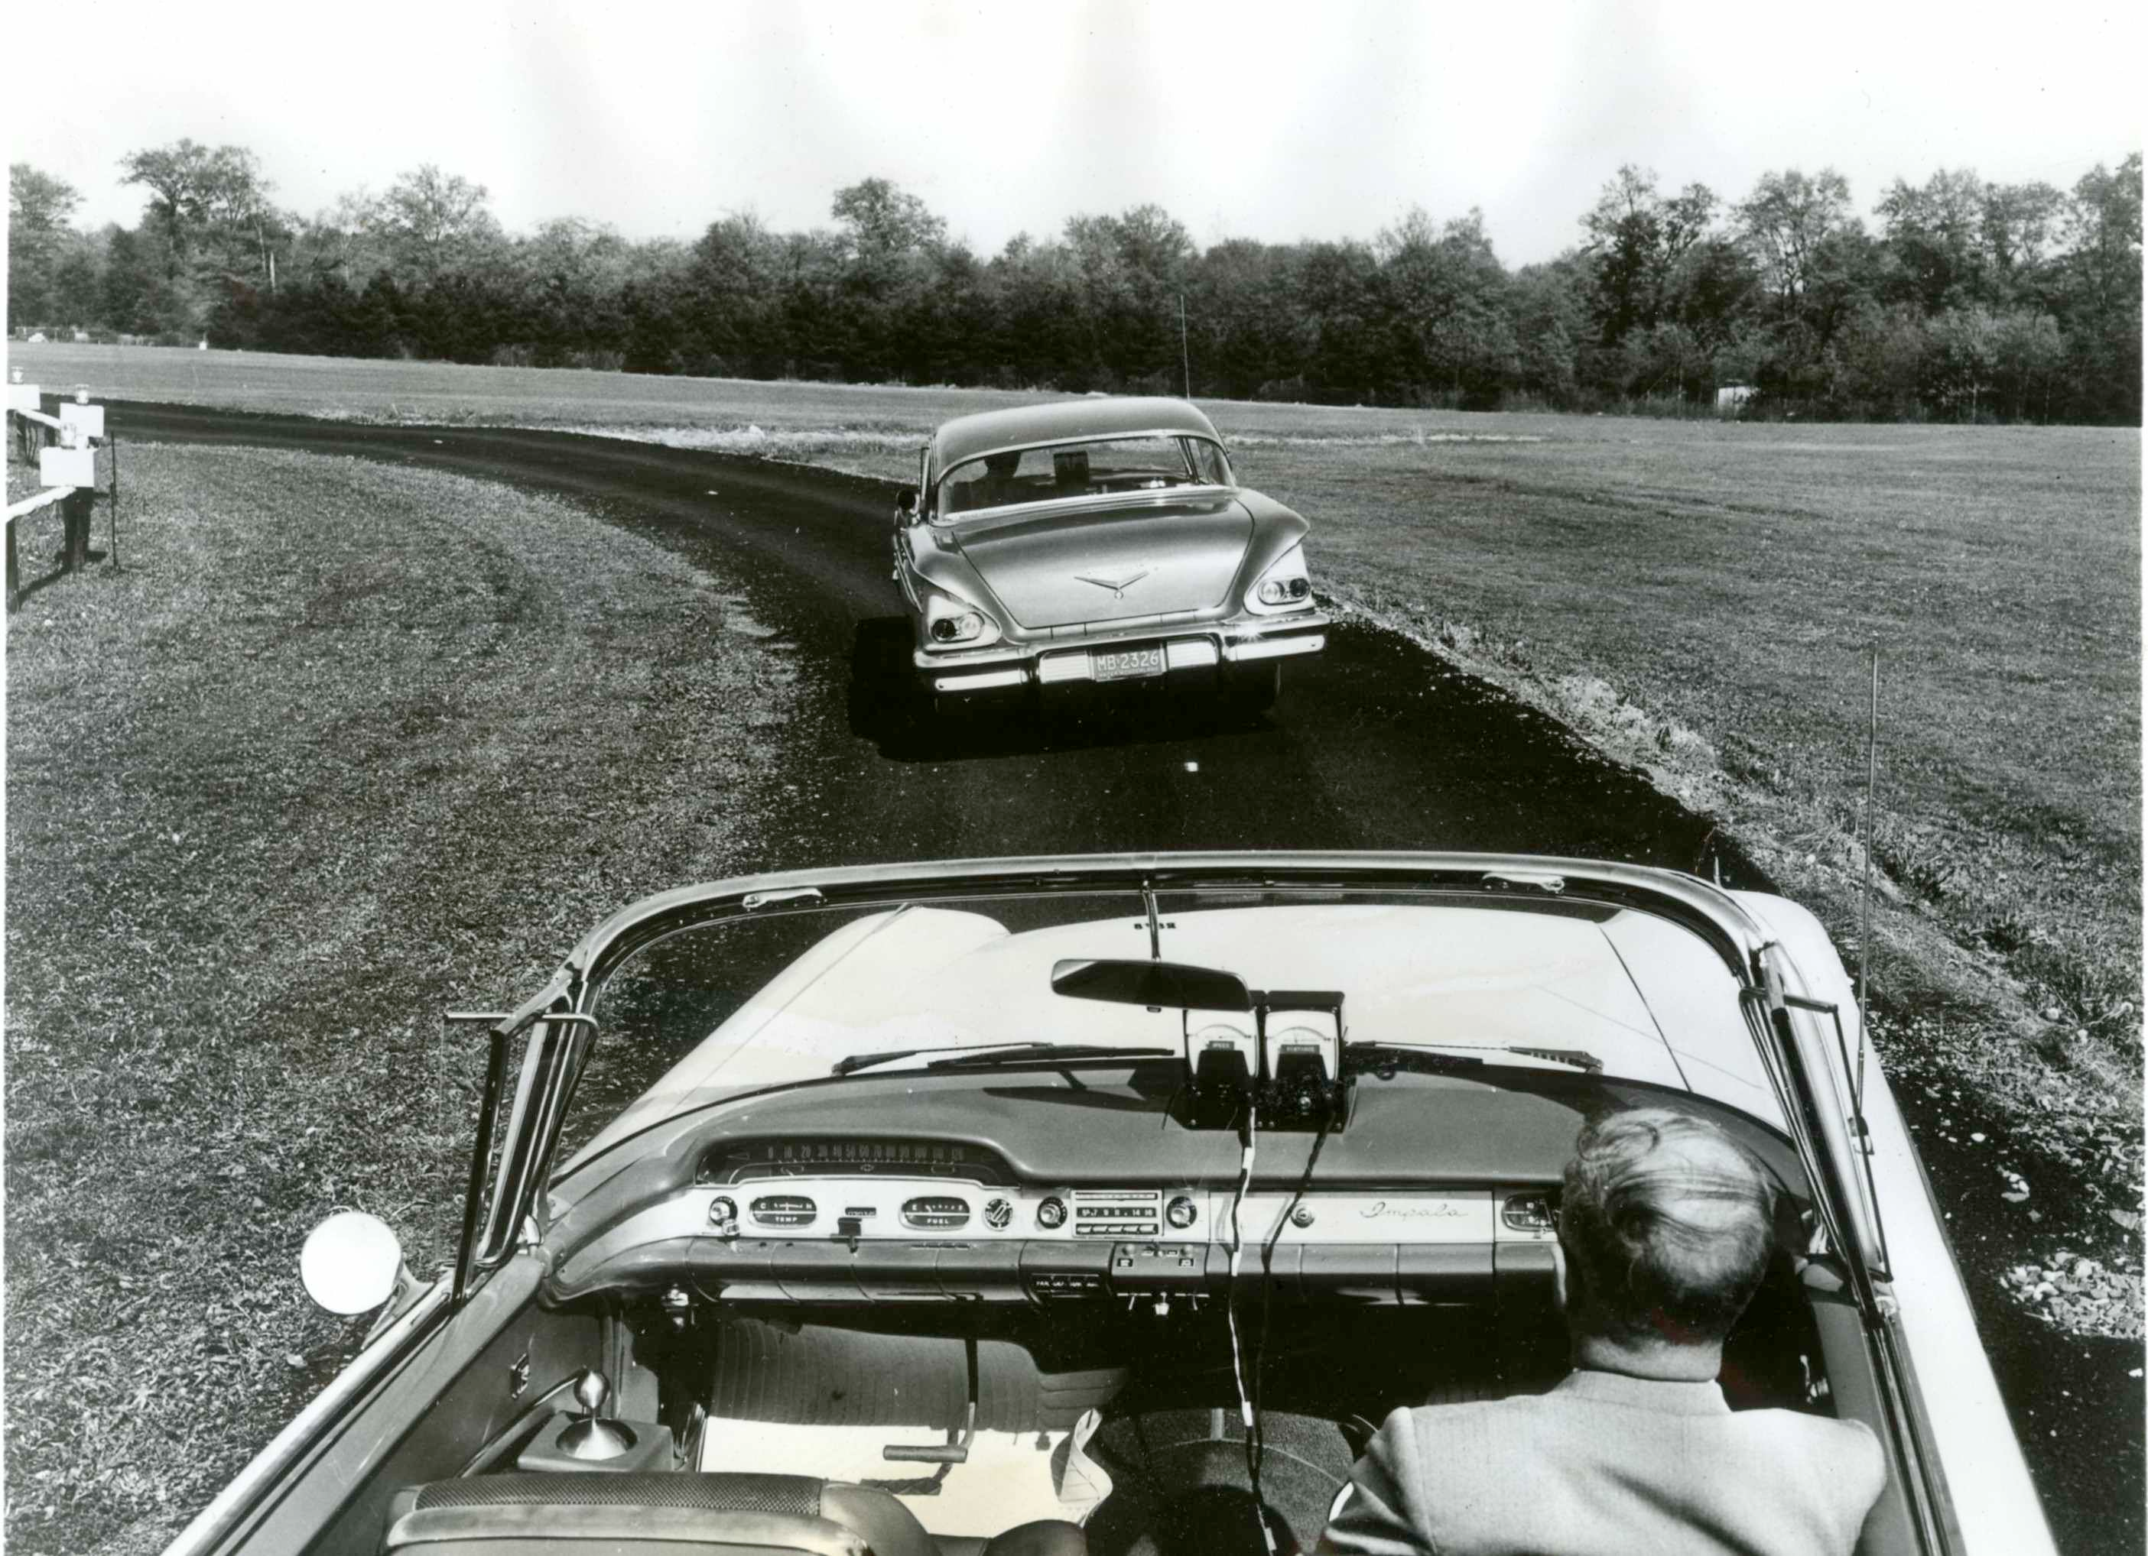
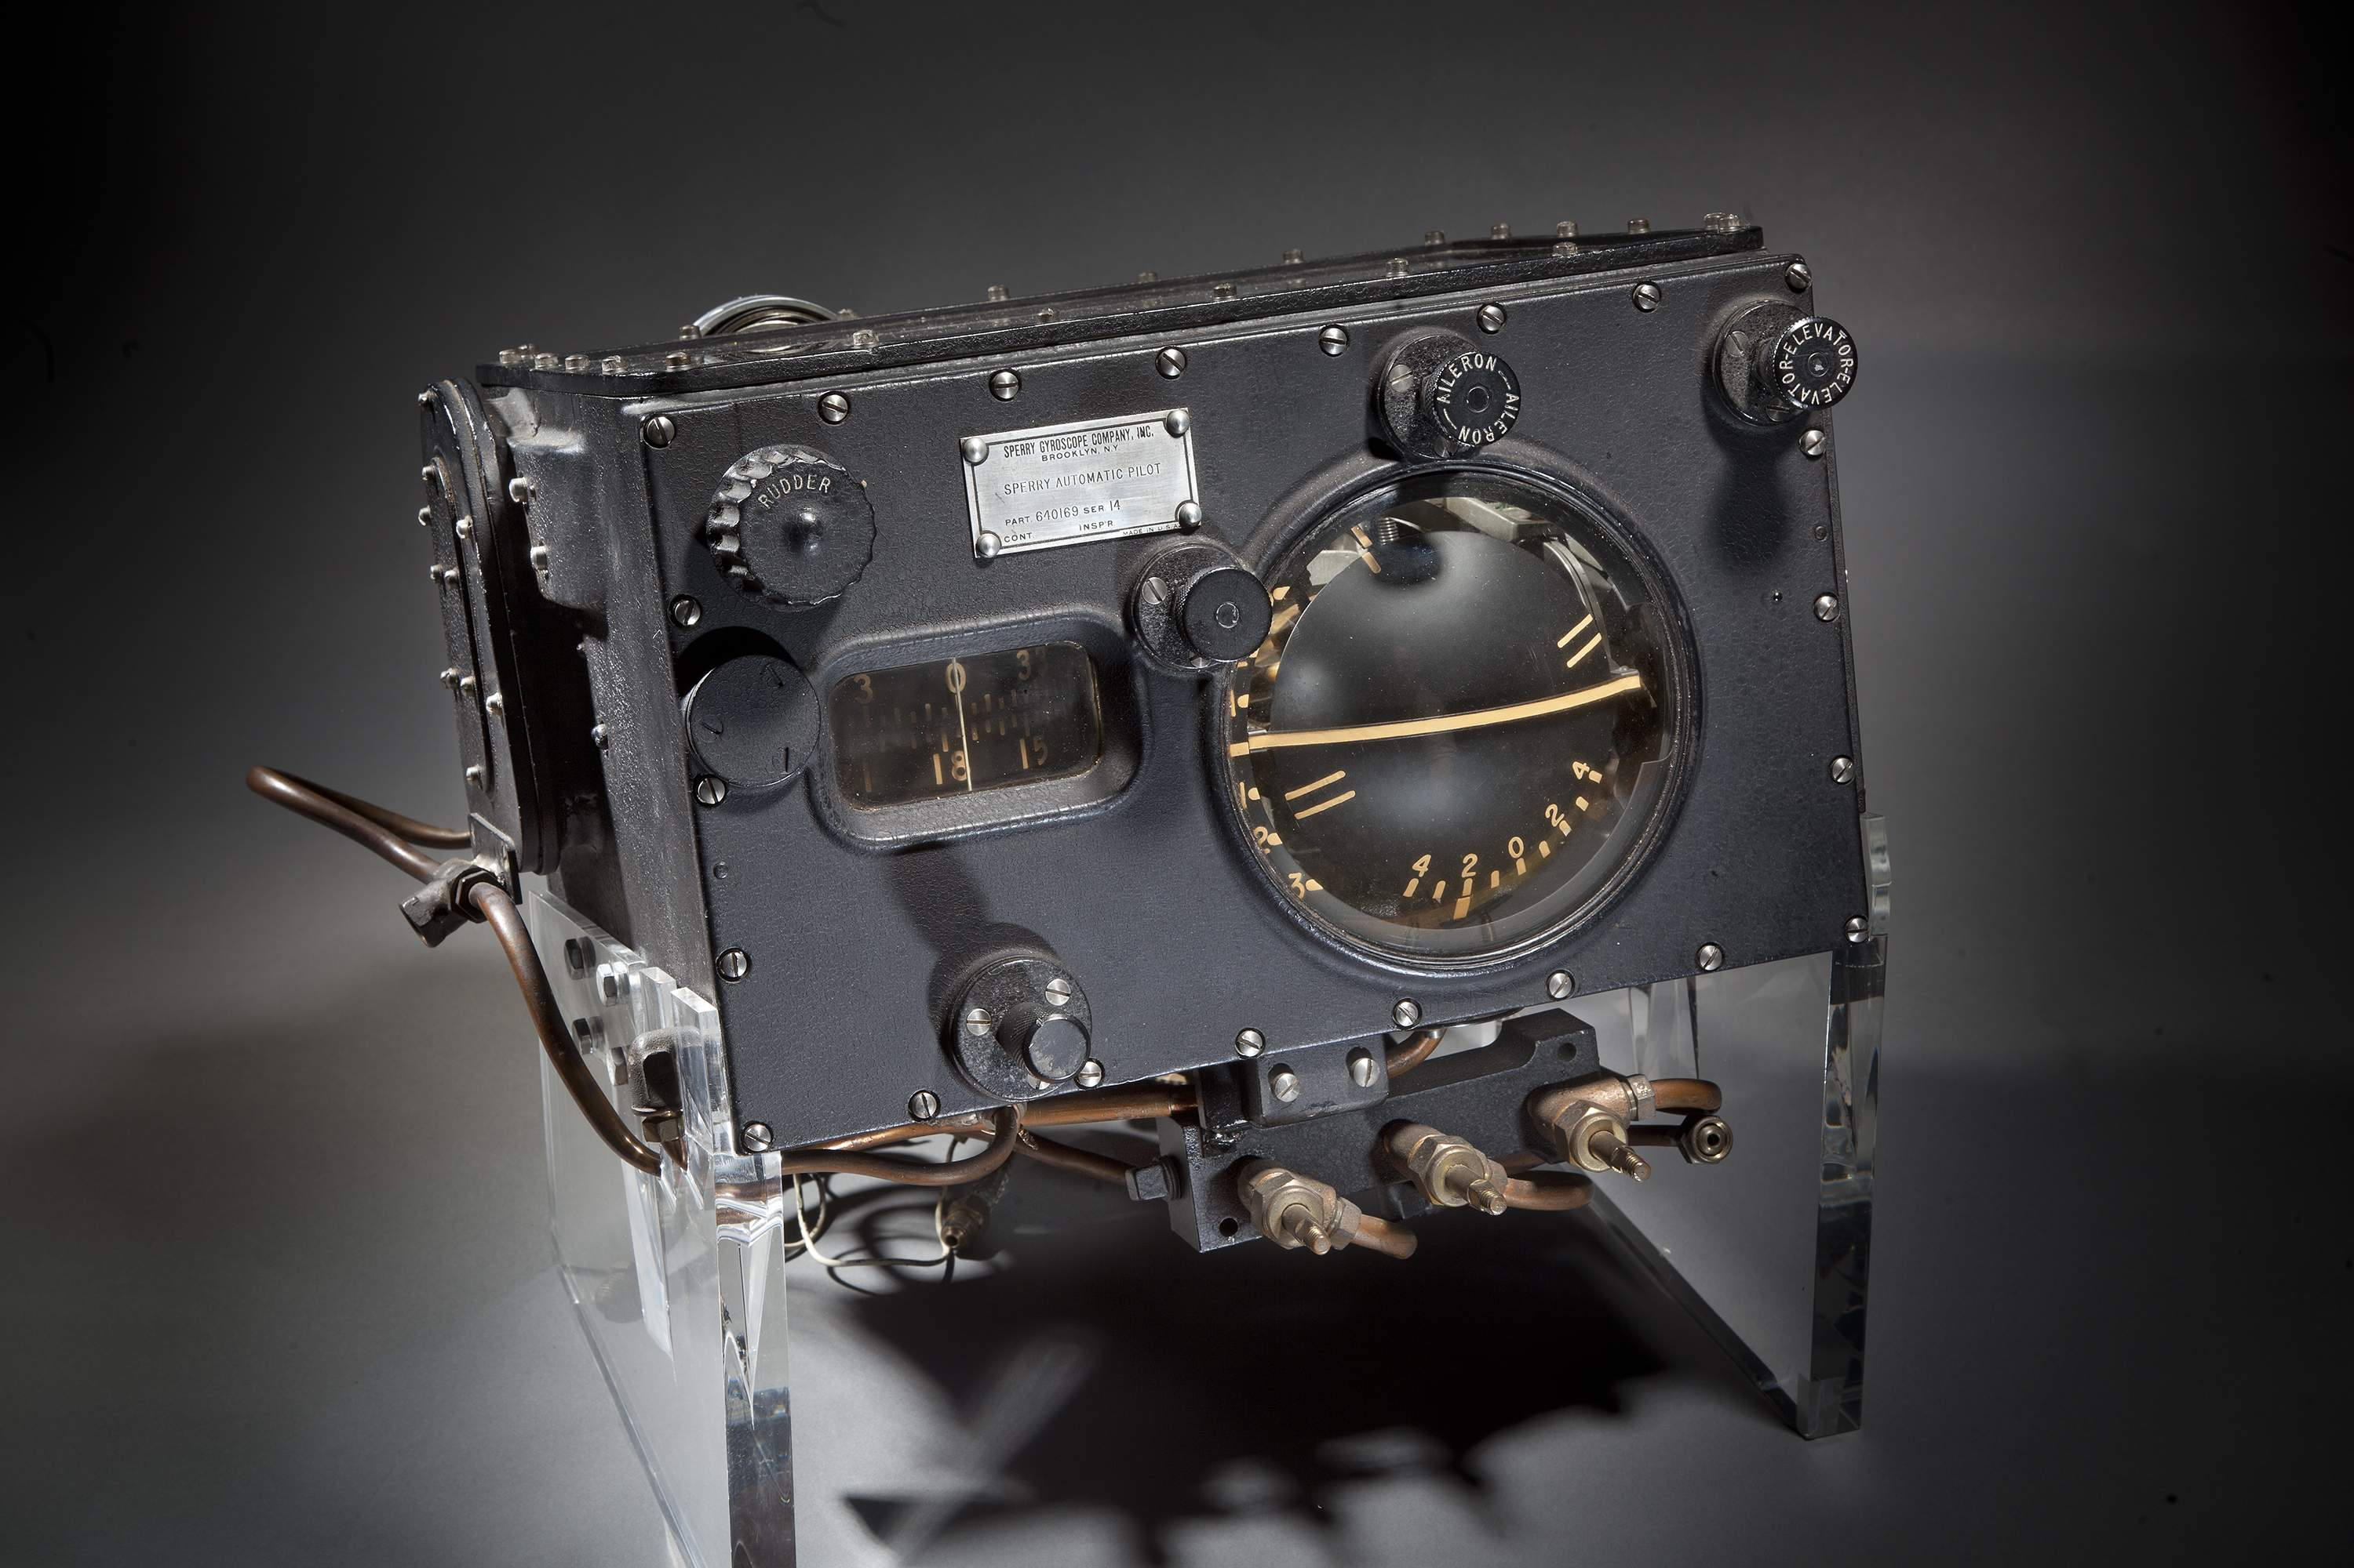
History of Autonomous Navigation
1
2
3
5
6
4
Notes:
(1) 1050 AD - Sailboats were likely the first self-propelled vehicles, and possibly the first to have some form of automated steering, the auto-tiller. Example shown is the later form of the Viking Long Boat, ‘The Knarr’, a 54’ design dating to around 1050, ship was supposedly one of the first to be primarily sail-driven – judging for few oarlocks and very high sides for additional cargo.
(2) 1478 AD - Sketch of a pre-programmed clockwork cart by Leonardo Da Vinci Had it been built, this cart would have been powered by large coiled clockwork springs, propelling it over 130 feet. The clever control mechanism could have taken the vehicle through a predetermined course. Credit: Biblioteca Ambrosiana, Milan, Italy / De Agostini Picture Library / Metis e Mida Informatica / Veneranda Biblioteca Ambrosiana / The Bridgeman Art Library
(3) 1860 AD - Robert Whitehead invented the self-propelled torpedo. The early guidance system for maintaining constant course and depth in the ocean. This was so new and essential he called it “The Secret.”. Pic. circa 1918 of Sopwotj Cuckoo bomber (piloted) launching Tropedo.
By WWII, Torpedos could home in on targets using SONAR (Sound Navigation and Ranging).
(4) 1930 AD: First semi-autonomous navigation in an aircraft. “Mechanical Mike” Autopilot, 1930s In 1933, Wiley Post became the first person to fly solo around the world. It might not have been possible without this Sperry Gyroscope autopilot, which allowed him to simultaneously fly and navigate. ~Credit: Photo by Eric Long, National Air and Space Museum, Smithsonian Institution (NASM 2012-01350)
(5) 1945 AD: German Vergeltungswaffe (“Vengeance Weapon”) 2 rocket aka V2. A pioneering ballistic missile, the V2 was the first human artifact in outer space. Gyroscopes kept it on course from Nazi-occupied France to London and Antwerp. Inventor Werner von Braun later developed the Apollo moon rockets. ~Credit: © IWM (BU 11149)
(6) 1950 AD: Autonomous Highway System test(s) by General Motors (GM) & Radio Corporation of America (RCA) GM and RCA developed automated highway prototypes with radio control for speed and steering. Magnets in the car tracked a steel cable embedded in the road; control towers managed overall traffic flow. ~Credit: Radio Corporation of America (RCA)

Slide 10
Autonomous Navigation in Modern Engineering
Land Vehicles
Air Vehicles
Marine Vehicles
Submarine Vehicles
Notes:
breakfast cereal was probably gathered by a driverless harvester.
Sailboats have auto-tillers.
Semi-autonomous military drones kill from the air (semi-autonomously or autonomously)
robot vacuum cleaners confuse our pets
Land Vehicles
Uses: take down
Miniature: Small robots, and perhaps even larger non-passenger vehicles (i.e. Mars Robot).
Unmanned: Man-size vehicles. I.e. Google Car proj, etc.
Off-Road/Multi-Terrain can use GPS and Aerial Images to navigate to off-road terrains.
Road vehicles use GPS and visual (and other sensors – i.e. laser or radar) to navigate through roads to get to desired destination avoiding passengers, curbs, etc. and abiding by road-signs.
Air Vehicles
Uses: military, surveillance (law enforcement), spying, fly passengers in the future?, geographic discovery, wildlife management/tracking, tracking down poachers, etc.
MAVs: Smaller than UAVs, no room for humans to fit. Allow versatility – can go to places UAVs can’t possibly go due to their size and the way they move. Include things like quadcopters and onithopters (aircraft that flies by flapping it’s wings).
UAVs: drones, flying aircrafts (usually the size of small aircraft, life-size or close to life-size).
The difference, other than size, is largely in the way the vehicles are fuelled and propelled. Control systems may vary drastically. May expect far more physical variables with (far to complicated for 6 month uni project)
The military distinguishes between "man in the loop"(piloted) and "man on the loop" (supervised) systems, with "fully autonomous" (issued orders) growing organically from the second into a third category (i.e. from slowly moving from some supervision to no su
Autonomous Navigation can focus on sticking to a generated air route to a particular (specified, or calculated) point of interest. Or it can be exploratory, i.e. flying to identify objects of interest and act accordingly (follow for surveillance, “strike”, capture footage).
Marine (Surface) Vehicles
ASVs are a category of USVs (Unmanned Surface Vehicles).
USVs are valuable in oceanography, as they are more capable than moored or drifting weather buoys, but far cheaper than the equivalentweather ships and research vessels,^{[1]} and more flexible than commercial-ship contributions. Wave gliders, in particular, harness wave energy for primary propulsion^{[2]} and, with solar cells to power their electronics, have months of marine persistence^{[3]} for both academic ^{[4][5]} and naval applications. ^{[6][7]}
Military applications for USVs include powered seaborne targets. Operational USVs with offensive capability include the Israeli Protector USV.^{[8]}
Submarine Vehicles
AUVs are a category of UUVs (Unmanned Underwater Vehicles), other subcategory being Remotely Operated Underwater Vehicle (ROVs).
Interesting as not commonly talked about. Uses:
“oil and gas industry uses AUVs to make detailed maps of the seafloor before they start building subsea infrastructure”
“Scientists use AUVs to study lakes, the ocean, and the ocean floor. A variety of sensors can be affixed to AUVs to measure the concentration of various elements or compounds, the absorption or reflection of light, and the presence of microscopic life”
Air Crash Investigation – find wreckages
Illegal Drug Trafficking – via GPS. DO NOT RECOMMEND.
Various sizes.
Difficulties sensing things underground.
Many challenges with underwater communication.
Therefore better to not discuss this is further detail, as it detracts from subject of autonomous navigation that learn.

Slide 11
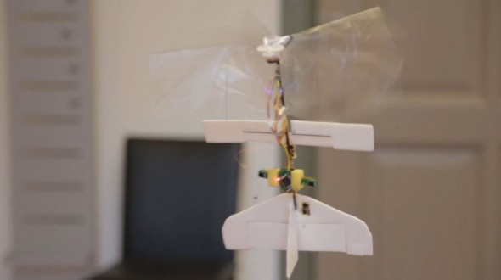
Autonomous Navigation: The Current Technology (MAVs)
DelFly Explorer (a Delft University of Technology project) “World’s Smallest and Lightest Self-Navigating Drone”, The Independent (2013)
Weighs 20g (of which controller board is only 4g)
Controller Board implements a number of stereo-vision based obstacle detection algorithms – especially fixated towards areas of low visual texture.
Controller Board also implements a control algorithm which performs short term path planning.

Slide 12
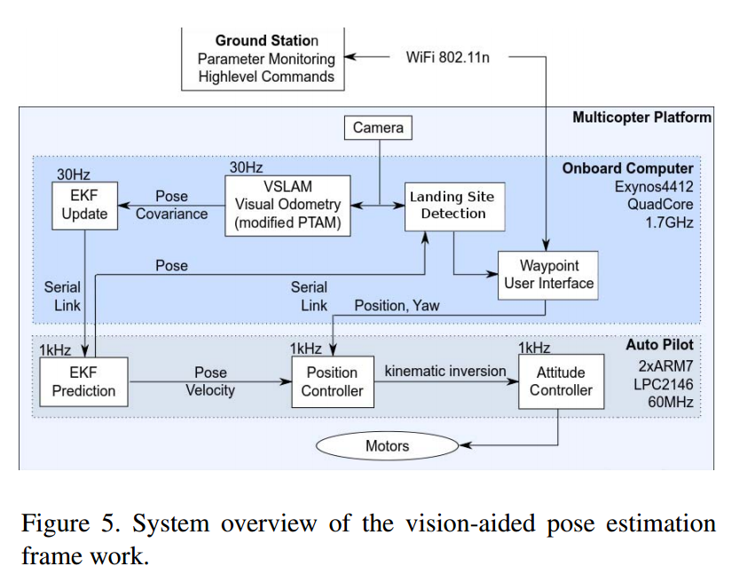
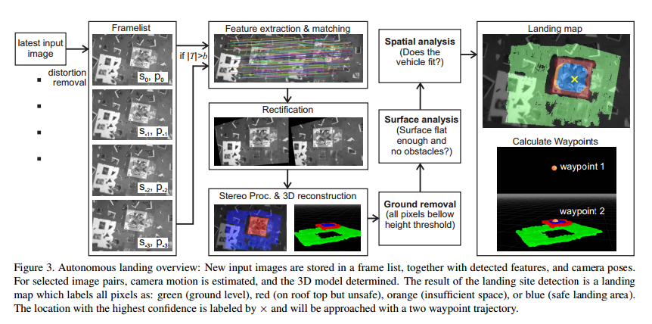
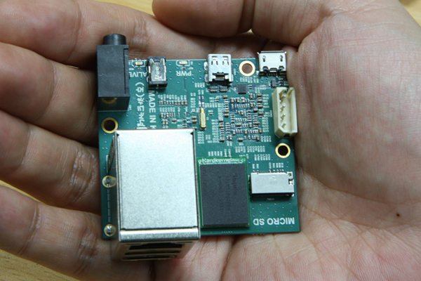
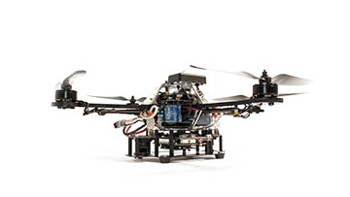
Autonomous Navigation: The Current Technology (MAVs)
+
Odroid-U2
AscTec Hummingbird (Chassis)
A recent method for autonomous navigation in MAVs
Visual and inertial sensors for GPS-independent 3D pose estimation which would be especially useful in a GPS-denied environment (creating artificial visual perception).
3D reconstruction of overflown terrain to find potential landing sites and generate landing trajectories for the purpose of autonomous landing
Notes:
R. Brockers, M. Humenberger and S. Weiss, "Towards Autonomous Navigation of Miniature UAV," in Computer Vision and Pattern Recognition Workshops (CVPRW), CVPR2014, Columbus, OH, USA, IEEE, 2014, pp. 631-637.
HardKernel Odroid U2 used as the FLIGHT COMPUTER
Exynos4412 Prime Processor: 1.7Ghz ARM Cortex-A9 Quad Cores
3D Accelerator!
Good Connectivity
10/100Mbps Ethernet (RJ-45 LAN Jack)
2 x High Speed USB2.0 USB
HDMI interface (1080p)
Audio codec and headphone jack on board
OS: Android 4.x & Ubuntu 12.10
Low-cost development platform (only $89!)
ONLY 5cm² in size!!
AscTec Hummingbird Chassis
Hummingbird comes with it’s own processor (Intel Core 2 Duo), but comparison shows that the U2’s processor works just as effectively (30% system load vs 31% system load), but weighs 96% less than the original board, and consumes 74% less power! Therefore Core 2 Duo scrapped for U2 board in final prototype. Both work @ 30fps frame rate. However, an additional ARM7 based MCU used to execute Autopilot algorithms.
Fig (1) : Landing Site Detection algorithm
Fig (2): System Overview

Slide 13

Autonomous Navigation: The Current Technology (MAV Fleet!)
Notes:
Recent research into automatic mission planning for fleet of
The ENAC University developing the Paparazzi UAV system - a free and fully autonomous autopilot for a fleet of MAV, including both fixed wing and rotary wing MAVs.

Slide 14
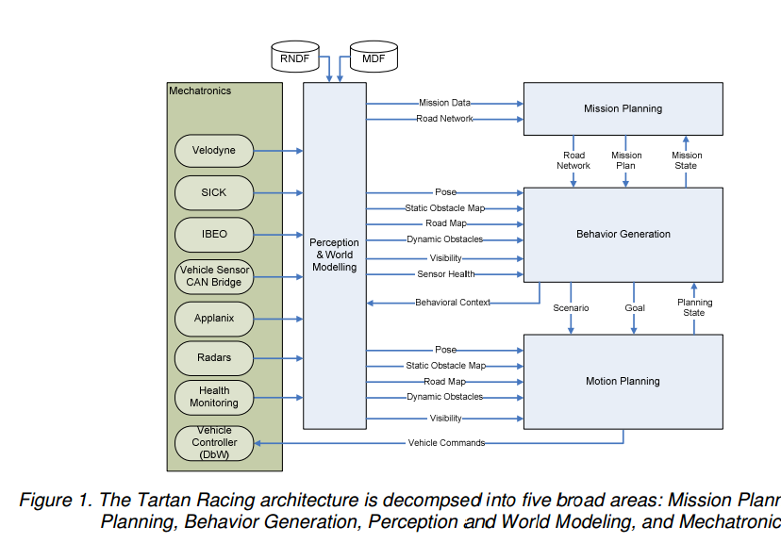
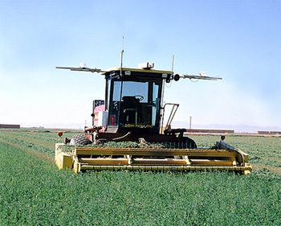
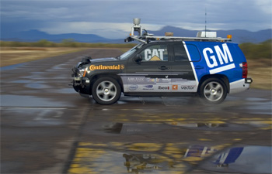
Autonomous Navigation: The Current Technology (Unmanned Land Vehicles)
Notes:
[1] breakfast cereal was probably gathered by a driverless harvester using GPS.
[2] Tartan Racing (DARPA Urban Challenge contender) decomposed the problems of urban driving into five components: mission planning layer to determine the most effective route amongst a network of roads, a behavioural layer to execute the route by adapting to local traffic and exceptional situations, a motion planning layer to safeguard the vehicle by identifying and selecting the most appropriate trajectories, the perception layer that combines data from LIDAR, radar and vision systems to map location of static objects, shape of road, and other vehicles, and the mechatronic system layer designed to provide power, sensing and mobility [8].
References
List of MAV frameworks within which autonomous navigation can be implemented. http://www.fsd.mw.tum.de/infrastructure/unmanned-systems/

Slide 15
Final Comment on Autonomous Navigation
Technically speaking, implementation is as difficult as the control system of the vehicle, if not more. Because information/data of surroundings has got to be put in to perspective of the current state of the vehicle (and the present environment), and then necessary control signals have to be generated.

Slide 16
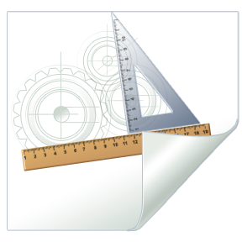
Technical Approach
Hardware Development, Software Development, and Demonstration… how are we going to go about it all?

Slide 17
Abstract Design

Slide 18
Development Resources: Hardware
Digilent® Nexys™ 3 FPGA Board
FPGA: Diligent Spartan-6 FPGA, XC6LX16-CS324 chipset operates @ 100MHz)
32Mbytes of Non Volatile RAM.
16Mbytes of Volatile RAM.
Digilent® VmodCAM Stereo Camera Module
2 × 2MP digital image sensors (1600px × 1200px) Allows for standard RGB565 output
15FPS @ max. resolution.
Up to 30FPS at lower resolutions.
allows for
BeagleBoard: BeagleBone Black
Based on 1GHz Processor based on ARM Cortex-A8 architecture.
512MB RAM.
4GB Flash Memory.
Wi-Fi connectivity.
Notes:
FPGA allows for implementation of fast and complex combinational and sequential logic.
Secondary Advantage is that: Any logic implemented in FPGAs through Hardware Description has the inherent ability to be scaled down to Application Specific ICs (ASICS) and System On Chips (SOCs) if ever it was to be used in industry at a huge scale).
ARM Cortex-A8 architecture allows O/S execution (i.e. Linux or Android) – saving development time, especially with regards to low-level programming and establishing Wireless connectivity with PC. Also 1GHz processor allows for fast execution of algorithms.

Slide 19
Development Resources: Software
Logic Development & Simulation: Xilinx® IDE, Altera® ModelSim
Algorithm Simulation: MathWorks® MATLAB & Simulink, or any preferred High-Level IDE.
Any programming IDE w/ GNU C Compiler to compile ARM Cortex-A8 executable code.
GUI development: Microsoft® Visual Studio .NET or QT C++.

Slide 20
Project Plan
What will be done, When it will be done, and Why it will be done in that order

Slide 21
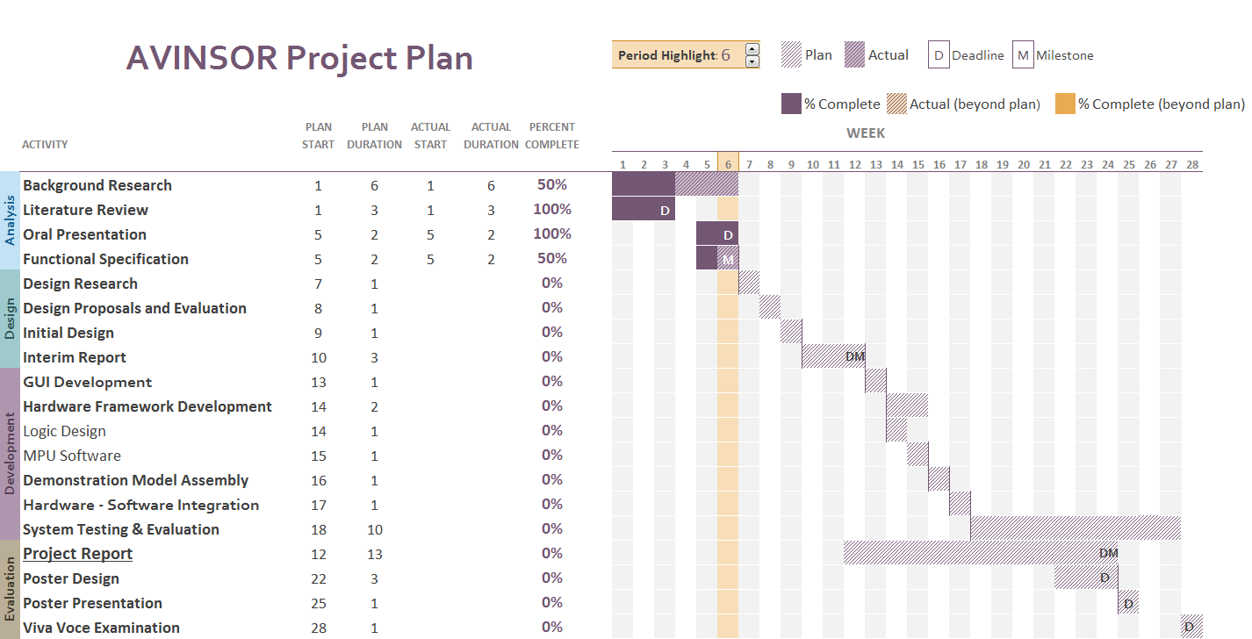
Activity Scheduling: Gant Chart

Slide 22
“Xtreme Engineering” Approach
Often used by Software Engineers.
May be considered with AVINSoR.
Basically involves ‘starting small’, and gradually improving the entire design and developed prototype in gradual steps.
This process is continued cyclically until all specifications are met.
If time allows, specifications may even be exceeded.
ALSO: Must consider the role of PC simulations to save development time by working on software simulations of algorithms whilst working on the underlying hardware framework and demonstration assembly.

Slide 23
Questions
Huh
Thank you for listening. Remember, you only have 5 minutes!

